Slide 1
MIC ARRAY

Slide 2
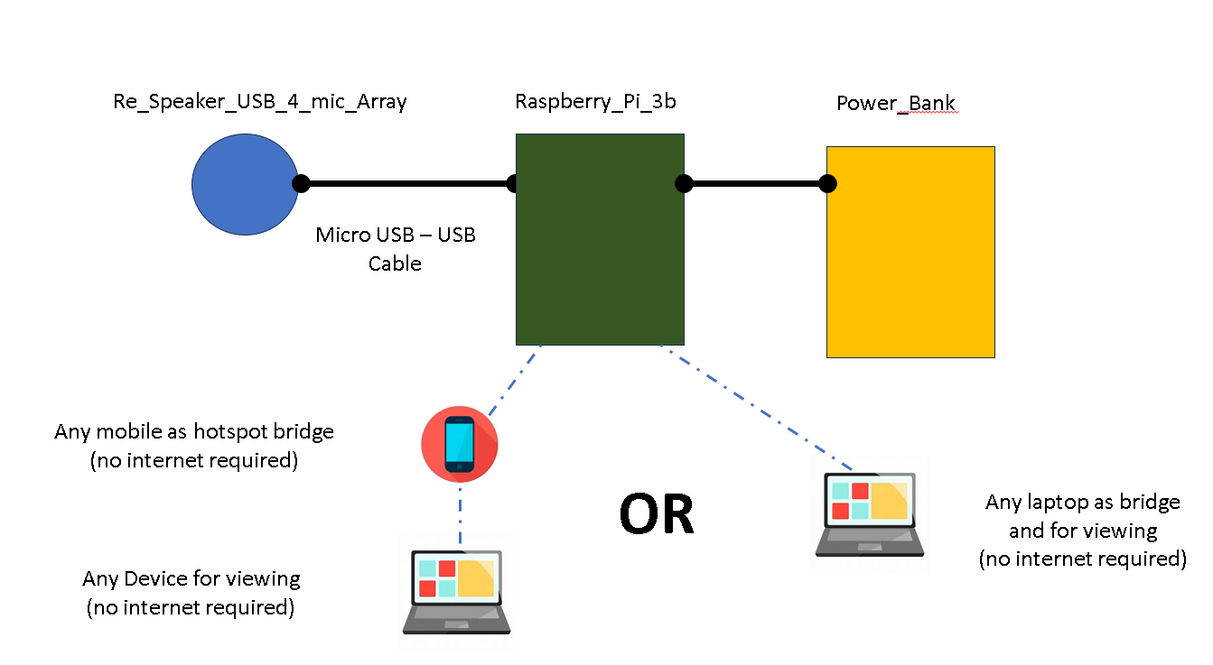
Overview of HW and SW…
HW
SW
Device
Z_ODAS - C code for direction calculation and other audio processing
Python code for updating settings, manage audio streaming, interacting with front end requests, mounting and managing drives
Tflite models and libraries for C integration
Front end visualizer and device manager in Node JS + React
User

Slide 3
Overview of HW and SW…
HW
Device
~/z_odas/
~/audio_stream
(file_chatak_audio_stream.py)
(chatak_audio_stream.py)
~/ChatakGUI/config/
~/ChatakGUI/
(update_ip.py)
(update_bandpass.py)
(update_settings.py)
(update_filePath.py)
(record.py)
(odas_manager.py)
~/odas/bin/build/config
FlashDrive:
/mnt/CHATAK_VM
(cors_https_server.py)

Slide 4
Overview of HW and SW…
Front End:
1.Viszualizer
a.Live
b.File
2.Settings
3.Simulator Reports
Pulse Audio
pcm : “multi_capture)
socket
file
ODAS
socket
Timestamp, id, type,
x,y,z,
Confidence,
Yammnet data
Yamnet

Slide 5
Overview of HW and SW…
Front End:
1.Viszualizer
a.Live
b.File
2.Settings
3.Simulator for Reports
Pulse Audio
pcm : “multi_capture)
socket
file
ODAS
socket
Timestamp, id, type,
x,y,z,
Confidence,
Yammnet data
Yamnet

